Slide 1
Combining Exemplar-Based and Deep Learning Techniques for Image Inpainting
Mariam Inants
2020

Slide 2
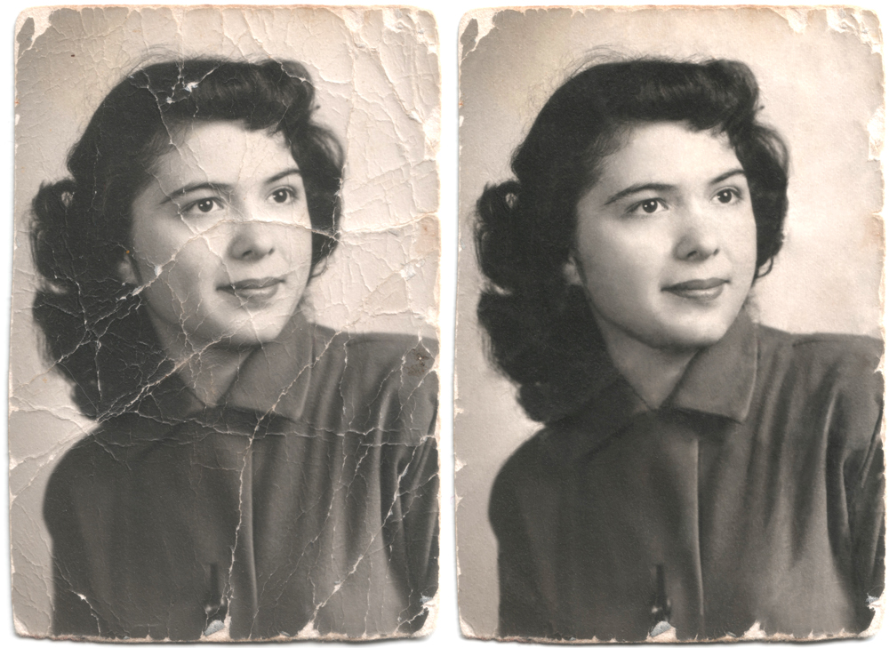
Introduction
The goal is to create a new
image inpainting method that
gives more efficient results than
existing ones.
Image inpainting can be defined
as the practice of restoring the
photograph which has been
damaged by natural, man
made, environmental causes or
simply affected by age.

Slide 3
Introduction
The goal is to create a new
image inpainting method that
gives more efficient results than
existing ones.
Image inpainting can be defined
as the practice of restoring the
photograph which has been
damaged by natural, man
made, environmental causes or
simply affected by age.

Slide 4
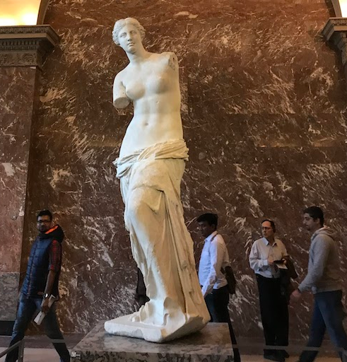
Introduction
During the time the demands of humans have changed.

Slide 5
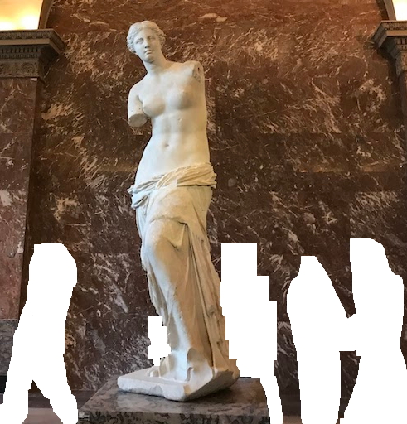
Introduction
During the time the demands of humans have changed.

Slide 6
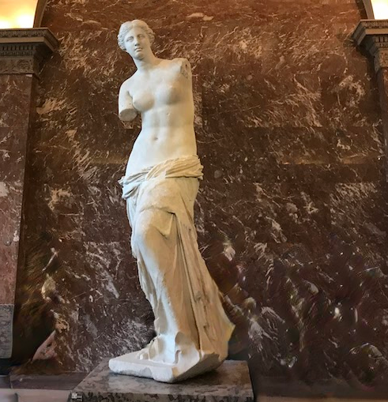
Introduction
During the time the demands of humans have changed.

Slide 7
Current Approaches
Two main groups of image inpainting algorithms can be found in literature: classic and
learning-based.
We create our own hybrid method.
Classic methods
Diffusion-based
Exemplar-based
Structure-based
Learning-based methods
Partial convolution based neural network
Hyprid method
Combination of the onion-peel filling algorithm and UNet-like architecture network .

Slide 8
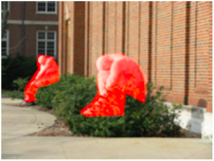
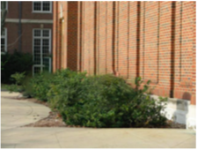
Problems of existing methods
Classic methods ¹
Learning-based
Hyprid method
¹ Huang, J. B., Kang, S. B., Ahuja, N., & Kopf, J. (2014). Image completion using planar structure guidance.

Slide 9
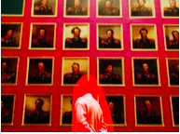
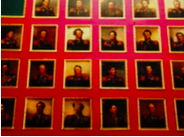
Problems of existing methods
Classic methods ¹
Learning-based
Hyprid method
¹ Huang, J. B., Kang, S. B., Ahuja, N., & Kopf, J. (2014). Image completion using planar structure guidance.

Slide 10
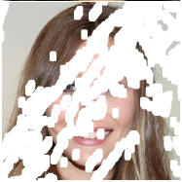
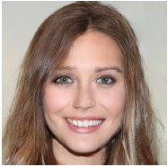
Problems of existing methods
Classic methods
Learning-based ²
Hyprid method
² Guilin Liu, Fitsum A. Reda, Kevin J. Shih, Ting-Chun Wang, Andrew Tao, Bryan Catanzaro: Image
Inpainting for Irregular Holes Using Partial Convolutions (2018)

Slide 11
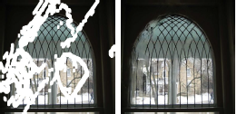
Problems of existing methods
Classic methods
Learning-based ²
Hyprid method
² Guilin Liu, Fitsum A. Reda, Kevin J. Shih, Ting-Chun Wang, Andrew Tao, Bryan Catanzaro: Image
Inpainting for Irregular Holes Using Partial Convolutions (2018)

Slide 12
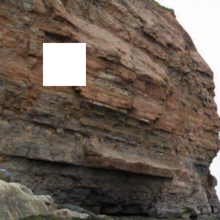
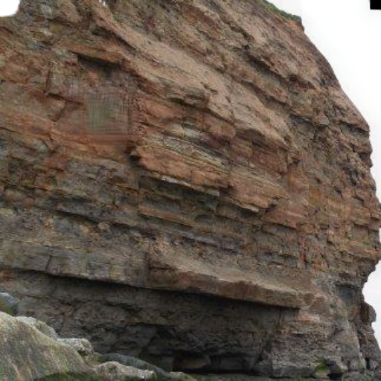
Problems of existing methods
Classic methods
Learning-based
Hyprid method

Slide 13
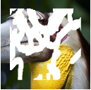
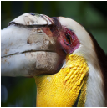
Problems of existing methods
Classic methods
Learning-based
Hyprid method

Slide 14
Our method
Our main contribution is to combine the onion-peel filling algorithm and neural networks.
Our hybrid method consists of :
The onion-peel filling algorithm,
UNet-like architecture network,
Partial convolutional layer.

Slide 15
The onion-peel filling algorithm,
UNet-like architecture network,
Partial convolutional layer.

Slide 16
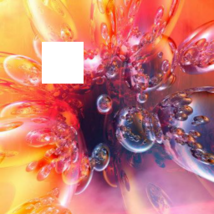
The onion-peel filling algorithm
We have image with hole (white square) and want to predict all unknown pixels in the hole.

Slide 17
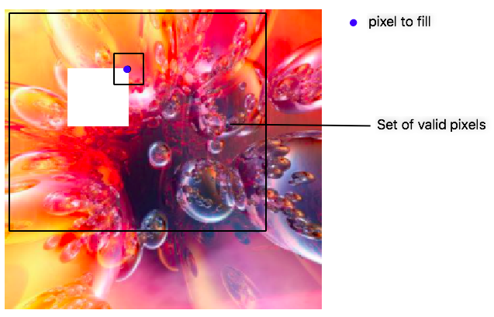
The onion-peel filling algorithm
The onion-peel filling algorithm ³ based on texture synthesis method, that sampling patches from a texture example and pasting them in the synthesized image.
³ "Texture Synthesis by Non-Parametric Sampling", A. A. Efros, T. K. Leung, Proc. IEEE ICCV (1999)

Slide 18
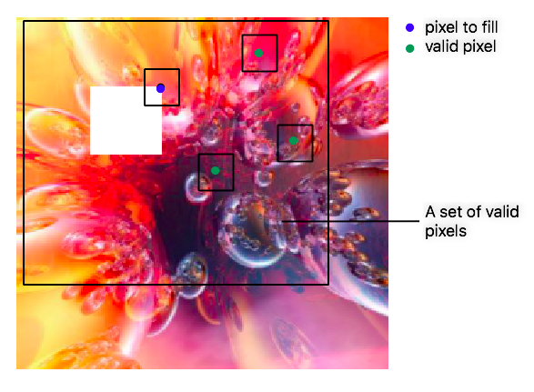
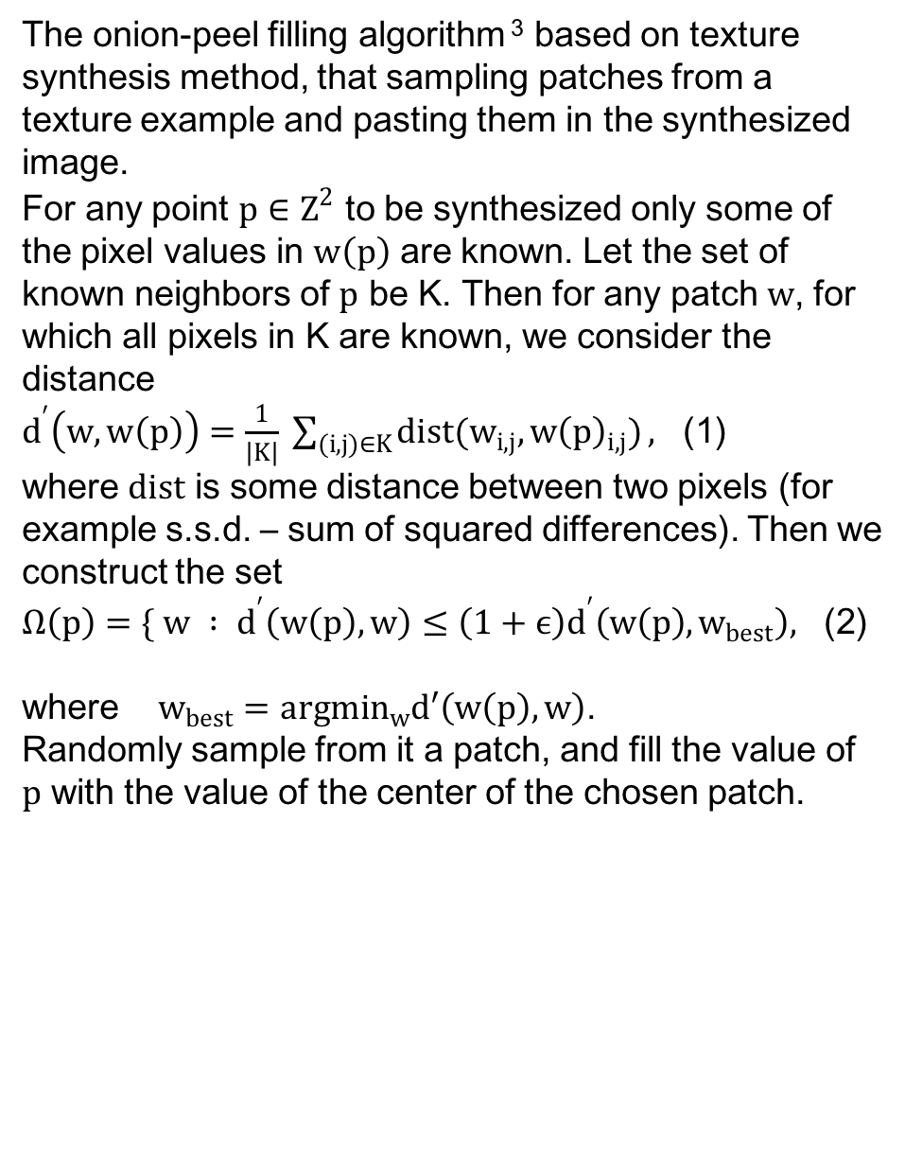
The onion-peel filling algorithm
The onion-peel filling algorithm ³ based on texture synthesis method, that sampling patches from a texture example and pasting them in the synthesized image.
For any point $p∈Z^{2}$ to be synthesized only some of the pixel values in $w\left(p\right)$ are known. Let the set of known neighbors of $p$ be K. Then for any patch $w$, for which all pixels in K are known, we consider the distance
$d^{′}\left(w,w\left(p\right)\right)=\frac{1}{\left|K\right|} \sum_{(i,j)∈K}{dist(w_{i,j},w{\left(p\right)}_{i,j})},$ (1)
where $dist$ is some distance between two pixels (for example s.s.d. – sum of squared differences). Then we construct the set
$Ω\left(p\right)=\{ w : d^{′}\left(w\left(p\right),w\right)≤\left(1+ϵ\right)d^{′}\left(w\left(p\right),w_{best}\right),$ (2)
where $w_{best}=argmin_{w}d′\left(w\left(p\right),w\right)$.
Randomly sample from it a patch, and fill the value of $p$ with the value of the center of the chosen patch.
³ "Texture Synthesis by Non-Parametric Sampling", A. A. Efros, T. K. Leung, Proc. IEEE ICCV (1999)

Slide 19
The onion-peel filling algorithm,
UNet-like architecture network,
Partial convolutional layer.

Slide 20
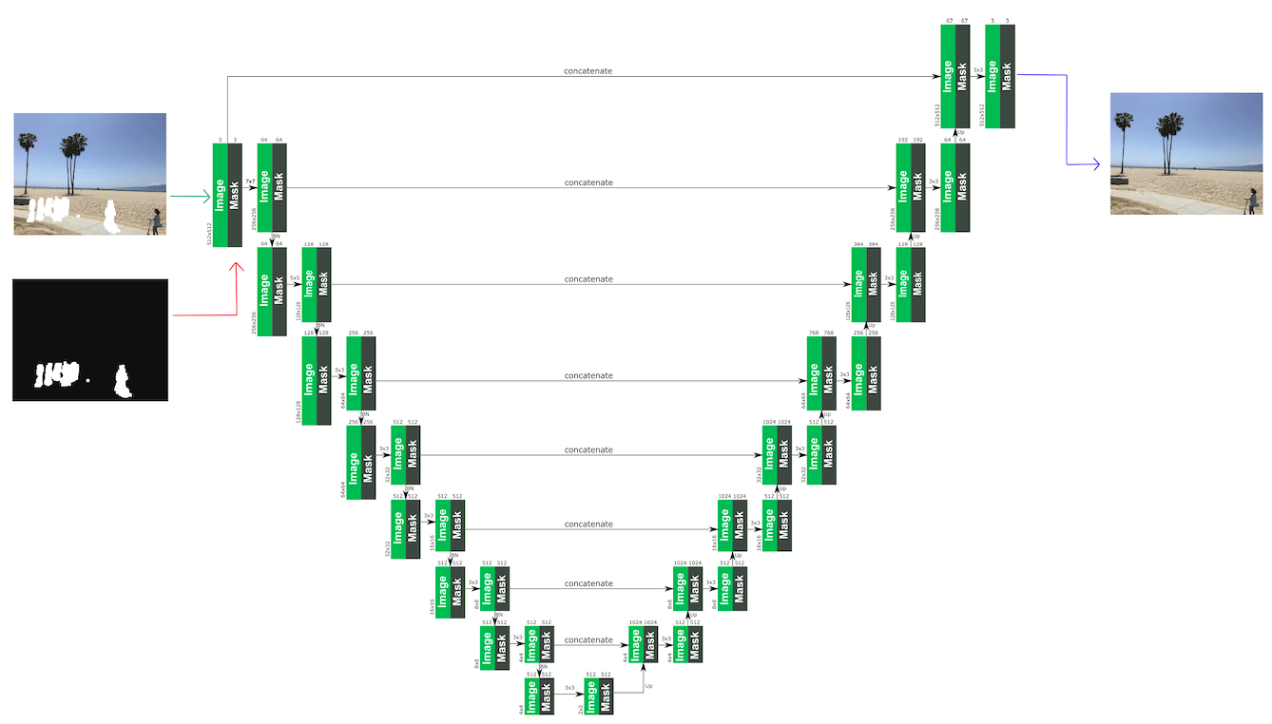
UNet-like architecture network
Output
Input

Slide 21
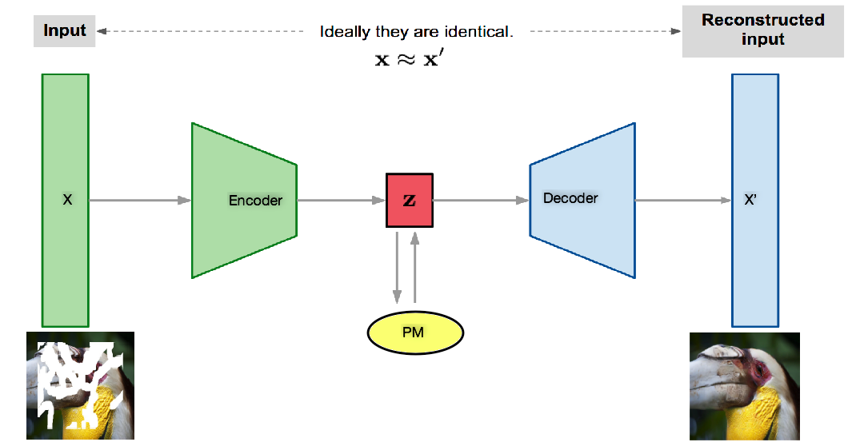
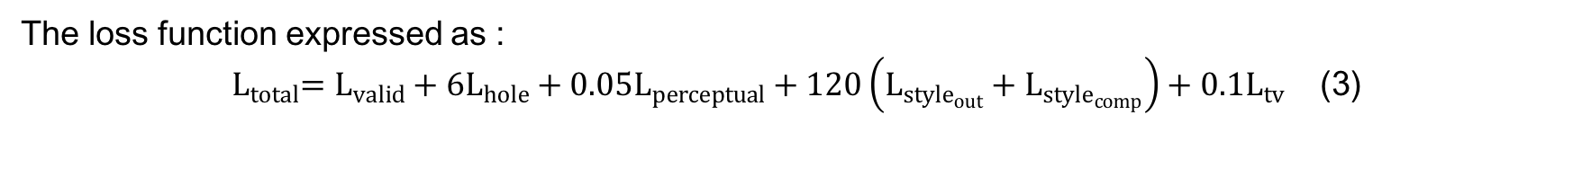
UNet-like architecture network
The loss function expressed as :
${ L}_{total}=L_{valid}+6L_{hole}+0.05L_{perceptual}+120\left(L_{style_{out}}+L_{style_{comp}}\right)+0.1L_{tv}$ (3)

Slide 22
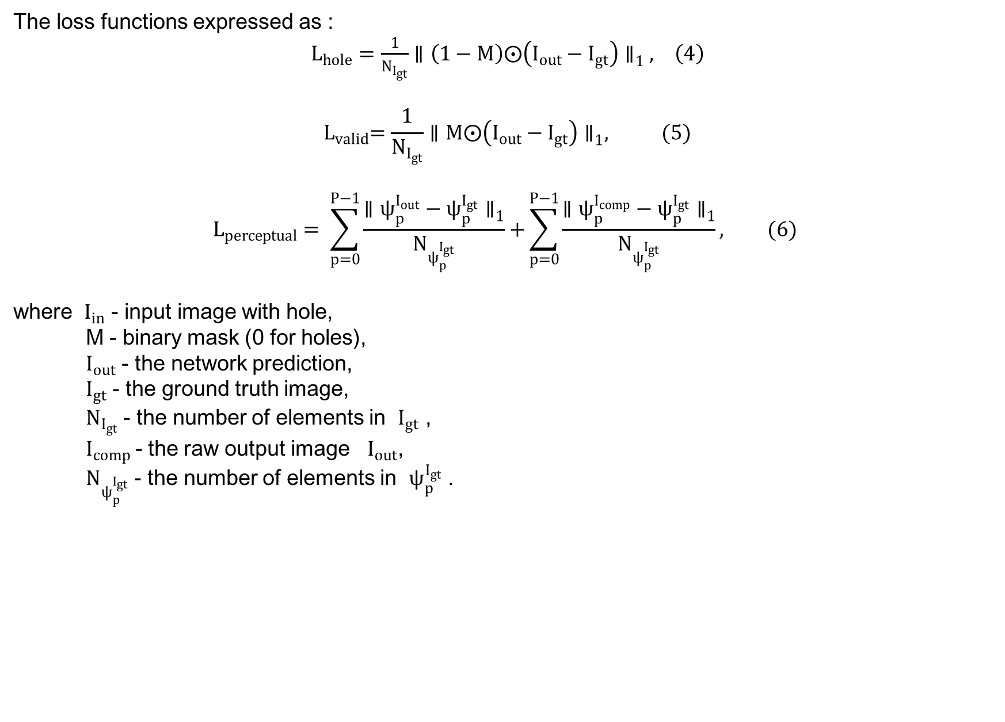
UNet-like architecture network
The loss functions expressed as :
$L_{hole}=\frac{1}{N_{I_{gt}}}∥\left(1−M\right)⨀\left(I_{out}−I_{gt}\right)∥_{1} , \left(4\right)$
$${ L}_{valid}=\frac{1}{N_{I_{gt}}}∥M⨀\left(I_{out}−I_{gt}\right)∥_{1}, (5)$$
$$L_{perceptual}= \sum_{p=0}^{P−1}{\frac{∥ψ_{p}^{I_{out}}−ψ_{p}^{I_{gt}}∥_{1}}{N_{ψ_{p}^{I_{gt}}}}+}\sum_{p=0}^{P−1}{\frac{∥ψ_{p}^{I_{comp}}−ψ_{p}^{I_{gt}}∥_{1}}{N_{ψ_{p}^{I_{gt}}}}}, (6)$$
where $I_{in}$ - input image with hole,
M - binary mask (0 for holes),
$I_{out}$ - the network prediction,
$I_{gt}$ - the ground truth image,
$N_{I_{gt}}$ - the number of elements in $I_{gt}$ ,
$I_{comp}$- the raw output image $I_{out}$,
$N_{ψ_{p}^{I_{gt}}}$ - the number of elements in $ψ_{p}^{I_{gt}}$ .

Slide 23
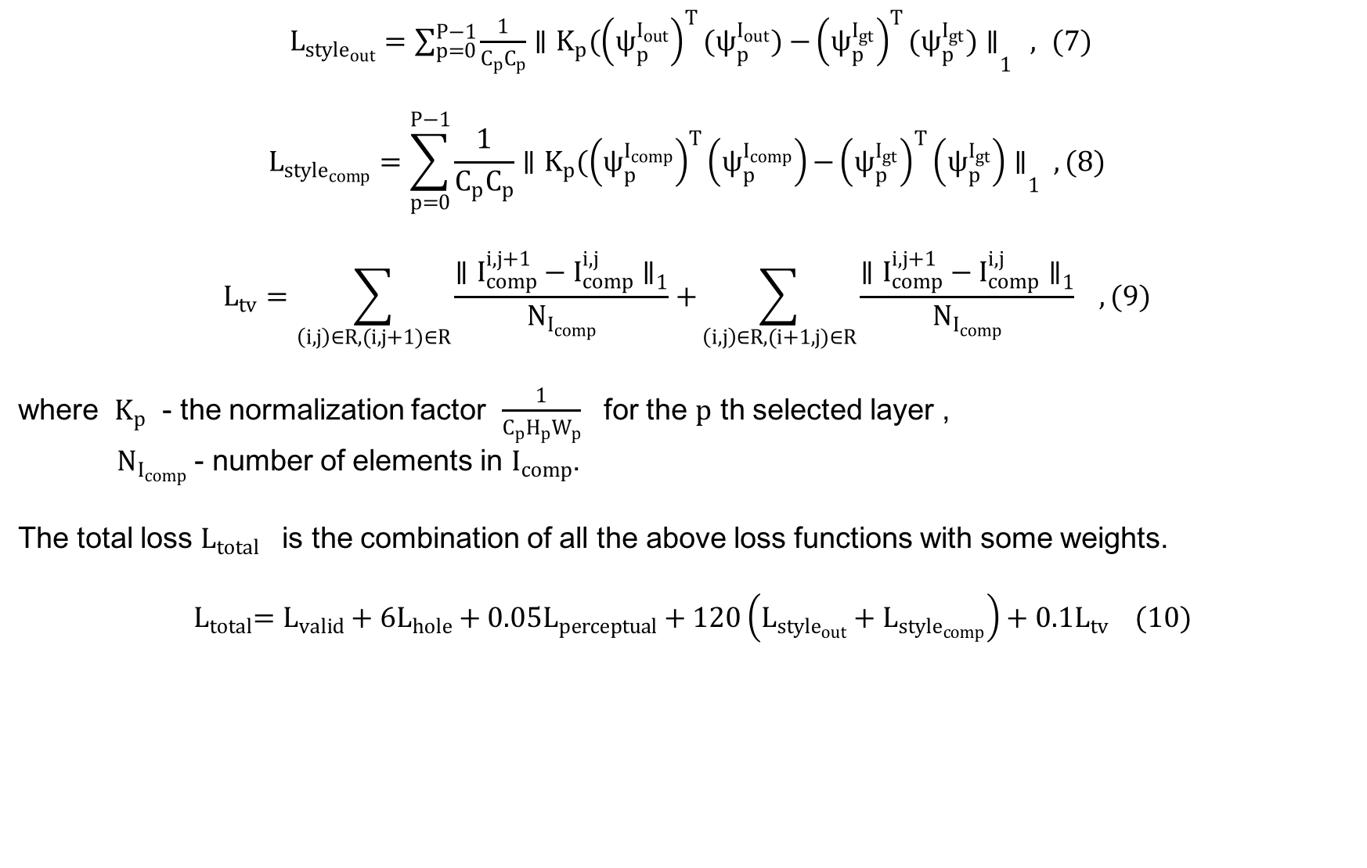
UNet-like architecture network
$L_{style_{out}}=\sum_{p=0}^{P−1}{\frac{1}{C_{p}C_{p}}∥K_{p}({\left(ψ_{p}^{I_{out}}\right)}^{T}(ψ_{p}^{I_{out}}){−{\left(ψ_{p}^{I_{gt}}\right)}^{T}(ψ_{p}^{I_{gt}})∥}_{1}} , (7)$
$$L_{style_{comp}}=\sum_{p=0}^{P−1}{\frac{1}{C_{p}C_{p}}∥K_{p}({\left(ψ_{p}^{I_{comp}}\right)}^{T}\left(ψ_{p}^{I_{comp}}\right){−{\left(ψ_{p}^{I_{gt}}\right)}^{T}\left(ψ_{p}^{I_{gt}}\right)∥}_{1} , (8)}$$
$$L_{tv}=\sum_{\left(i,j\right)∈R,(i,j+1)∈R}{\frac{∥I_{comp}^{i,j+1}−I_{comp}^{i,j}∥_{1}}{N_{I_{comp}}}+}\sum_{\left(i,j\right)∈R,(i+1,j)∈R}{\frac{∥I_{comp}^{i,j+1}−I_{comp}^{i,j}∥_{1}}{N_{I_{comp}}}} , (9)$$
where $K_{p}$ - the normalization factor $\frac{1}{C_{p}H_{p}W_{p}}$ for the $p$ th selected layer ,
$N_{I_{comp}}$ - number of elements in $I_{comp}$.
The total loss $L_{total}$ is the combination of all the above loss functions with some weights.
${ L}_{total}=L_{valid}+6L_{hole}+0.05L_{perceptual}+120\left(L_{style_{out}}+L_{style_{comp}}\right)+0.1L_{tv} (10)$

Slide 24
The onion-peel filling algorithm,
UNet-like architecture network,
Partial convolutional layer.

Slide 25
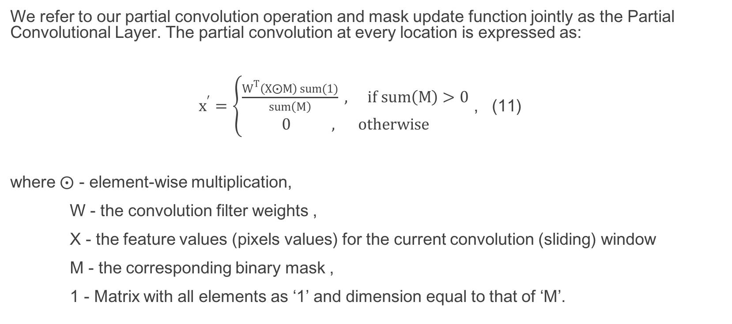
Partial Convolutional Layer
We refer to our partial convolution operation and mask update function jointly as the Partial Convolutional Layer. The partial convolution at every location is expressed as:
$x^{′}=\left\{\begin{aligned}\frac{W^{T}\left(X⨀M\right) sum(1)}{sum\left(M\right)} , if sum\left(M\right)>0 \\ 0 , otherwise\end{aligned}\right.$ , (11)
where $⨀$ - element-wise multiplication,
W - the convolution filter weights ,
X - the feature values (pixels values) for the current convolution (sliding) window
M - the corresponding binary mask ,
1 - Matrix with all elements as ‘1’ and dimension equal to that of ‘M’.

Slide 26
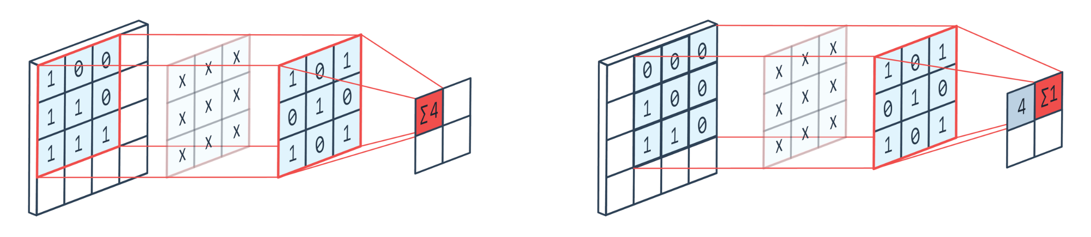
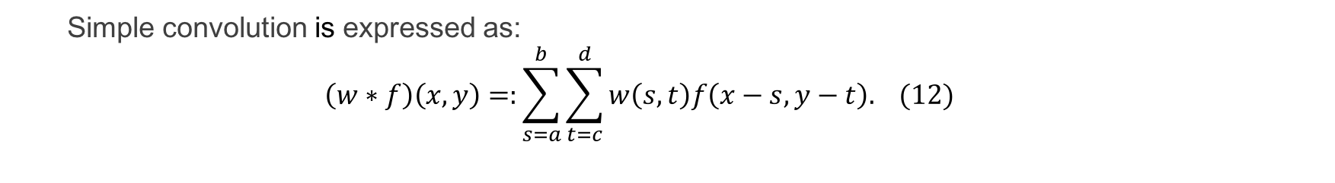
Partial Convolutional Layer
Simple convolution is expressed as:
$$\left(w∗f\right)\left(x,y\right)=:\sum_{s=a}^{b}{\sum_{t=c}^{d}{w\left(s,t\right)f\left(x−s,y−t\right). (12)}}$$

Slide 27
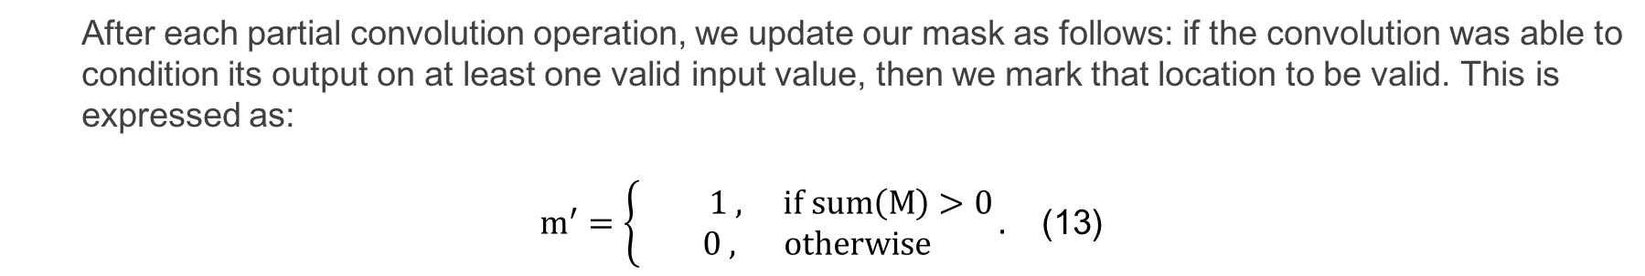
Partial Convolutional Layer
After each partial convolution operation, we update our mask as follows: if the convolution was able to
condition its output on at least one valid input value, then we mark that location to be valid. This is
expressed as:
$m^{′}=\left\{\begin{aligned} 1 , if sum\left(M\right)>0 \\ 0 , otherwise\end{aligned}\right..$ (13)
0 | 0 | 0 | 0 | 0
0 | x1 | x2 | ... | 0
0 | ... | ... |  | 0
0 |  |  | x9 | 0
0 | 0 | 0 | 0 | 0
0 | 0 | 0 | 0 | 0
0 | 1 | 1 | 1 | 0
0 | 1 | 1 | 1 | 0
0 | 1 | 1 | 1 | 0
0 | 0 | 0 | 0 | 0
z1 | z2 | ...
z6 | z7 | …
… | …
1 | 1 | 1 | 1 | 1
1 | 1 | 1 | 1 | 1
1 | 1 | 1 | 1 | 1
1 | 1 | 1 | 1 | 1
1 | 1 | 1 | 1 | 1
PConv
1 | 2
3 | 4
Input
Input Mask
Kernel
Output
Output Mask

Slide 28
Experiments
Our goal is to find more efficient and fast algorithm for image inpainting. First lets generate some random masks and fill them.
We combine patch-based and deep learning techniques and make three experiments:
Combine the onion-peel filling algorithm, UNet-like architecture network and
Partial Convolutional Layer,
Combine the onion-peel filling algorithm, Autoencoder and Partial Convolutional Layer,
Implement the onion-peel filling algorithm and make some limitations.

Slide 29
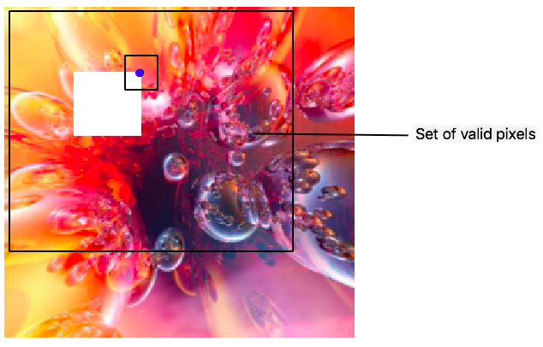
Experiment 1
During this experiment, we implement the onion-peel filling algorithm, then make some modification (limitation). In modified version each pixel to fill will have its own set of valid pixels, which is smaller than original one.

Slide 30
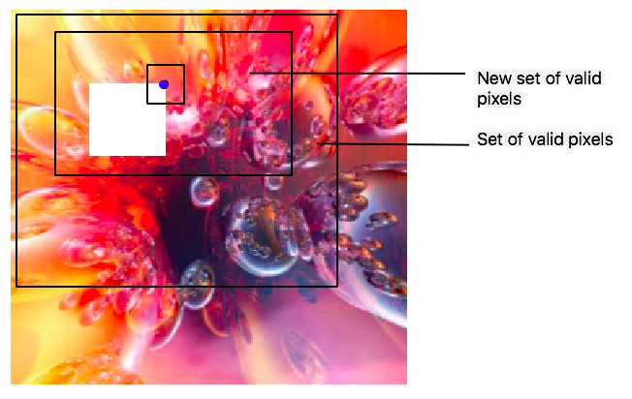
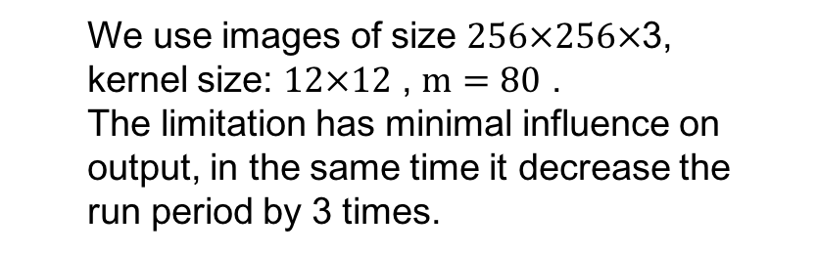
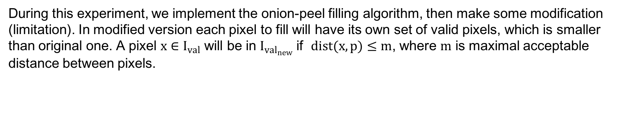
Experiment 1
During this experiment, we implement the onion-peel filling algorithm, then make some modification (limitation). In modified version each pixel to fill will have its own set of valid pixels, which is smaller than original one. A pixel $x∈I_{val}$ will be in $I_{val_{new}}$ if $dist(x,p)≤m$, where $m$ is maximal acceptable distance between pixels.
We use images of size $256×256×$3,
kernel size: $12×12$ , $m=80$ .
The limitation has minimal influence on
output, in the same time it decrease the
run period by 3 times.

Slide 31
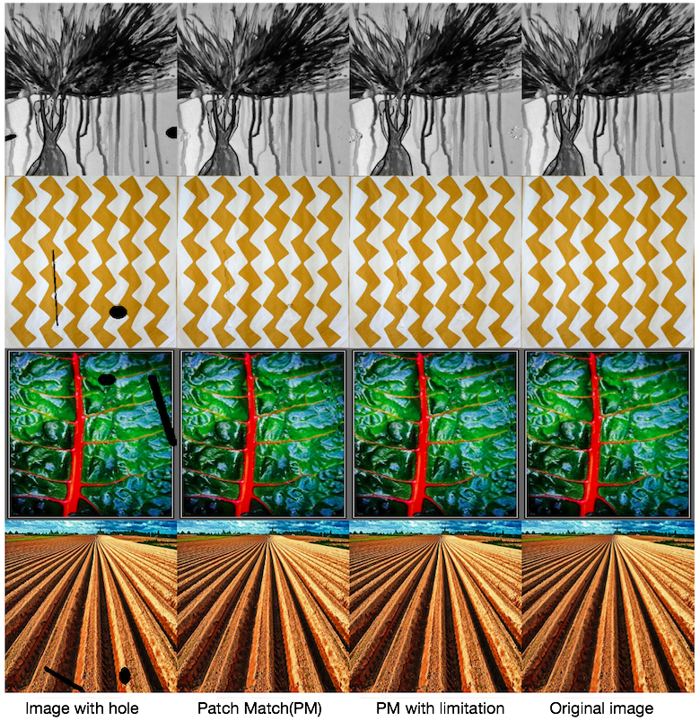
Results
Image with hole The onion-peel filling
The onion-peel filling
with limitation
Original image

Slide 32
Results
Image with hole The onion-peel filling
The onion-peel filling
with limitation
Original image

Slide 33
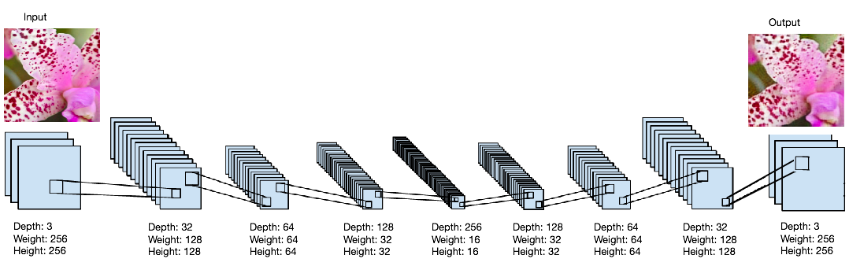
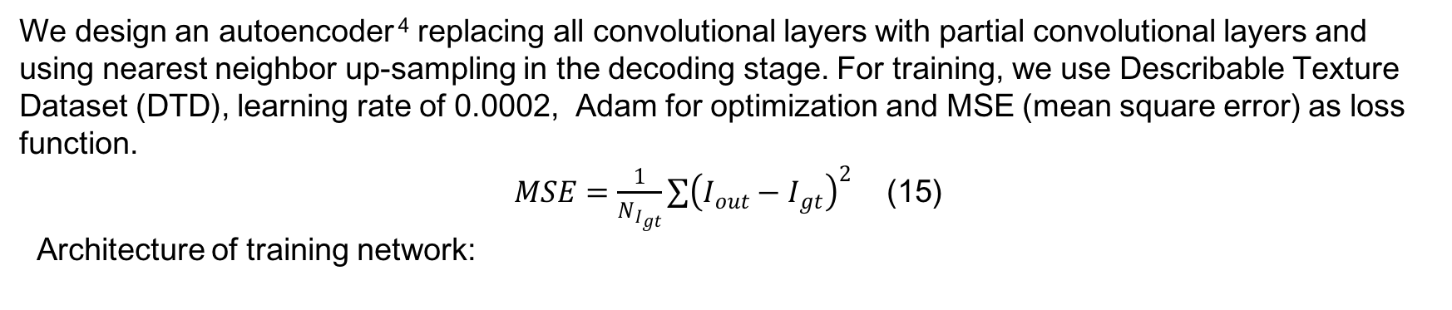
Experiment 2
We design an autoencoder ⁴ replacing all convolutional layers with partial convolutional layers and using nearest neighbor up-sampling in the decoding stage. For training, we use Describable Texture Dataset (DTD), learning rate of 0.0002, Adam for optimization and MSE (mean square error) as loss function.
$MSE=\frac{1}{N_{I_{gt}}}\sum{{\left(I_{out}−I_{gt}\right)}^{2}}$ (15)
Architecture of training network:
⁴ Xiao-Jiao Mao, Chunhua Shen, Yu-Bin Yang : Image Restoration Using Convolutional Autoencoders with
Symmetric Skip Connections (2016)

Slide 34
Experiment 2
In the inference process, we import the onion-peel filling algorithm. Encoder convert image of size 256×256×3 to size of 16×16×256, then the onion-peel filling( PM in figure) remove existing hole and decoder reconstruct image to size of 256×256×3.

Slide 35
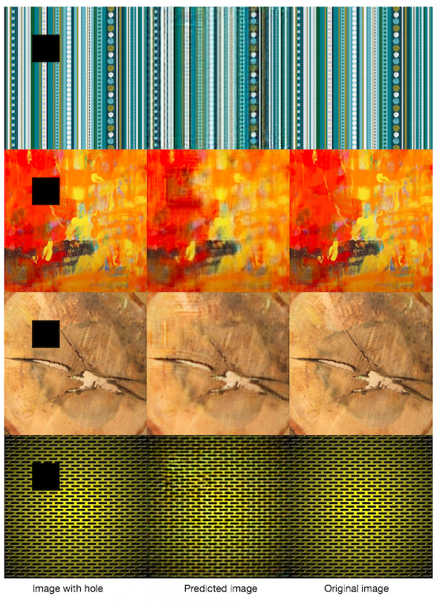
Results
Image with hole Predicted image Original image

Slide 36
Results
Image with hole Predicted image Original image

Slide 37
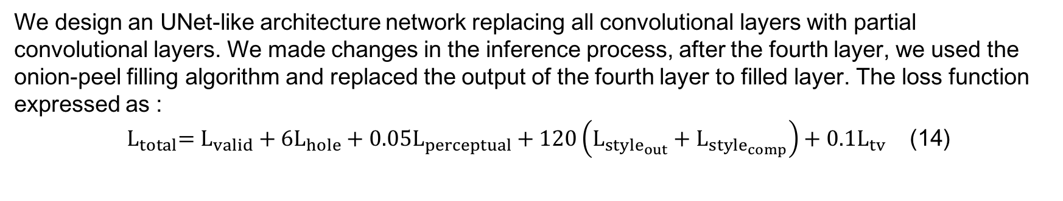
Experiment 3
We design an UNet-like architecture network replacing all convolutional layers with partial convolutional layers. We made changes in the inference process, after the fourth layer, we used the onion-peel filling algorithm and replaced the output of the fourth layer to filled layer. The loss function expressed as :
${ L}_{total}=L_{valid}+6L_{hole}+0.05L_{perceptual}+120\left(L_{style_{out}}+L_{style_{comp}}\right)+0.1L_{tv}$ (14)

Slide 38
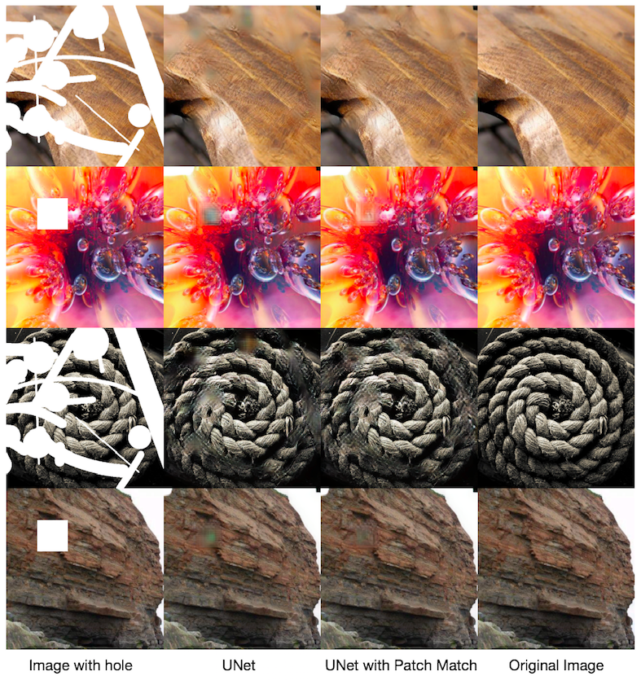
Results
Image with hole UNet
UNet with the onion-peel filling
Original image

Slide 39
Results
Image with hole UNet
UNet with the onion-peel filling
Original image

Slide 40
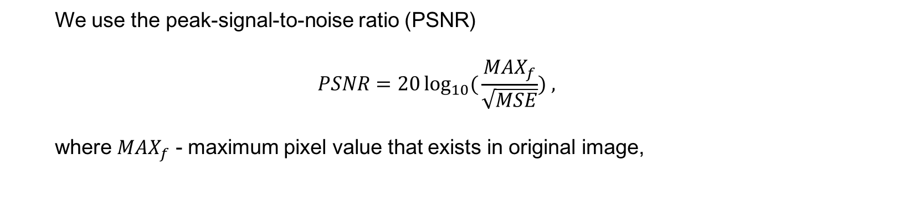
Comparison
 | Autoencoder with the onion-peel filling | UNet with the onion-peel filling | UNet
PSNR | 23.315 | 26.614 | 26.304
We use the peak-signal-to-noise ratio (PSNR)
$$PSNR=20\log_{10}({\frac{MAX_{f}}{\sqrt{MSE}}) ,}$$
where $MAX_{f}$ - maximum pixel value that exists in original image,

Slide 41
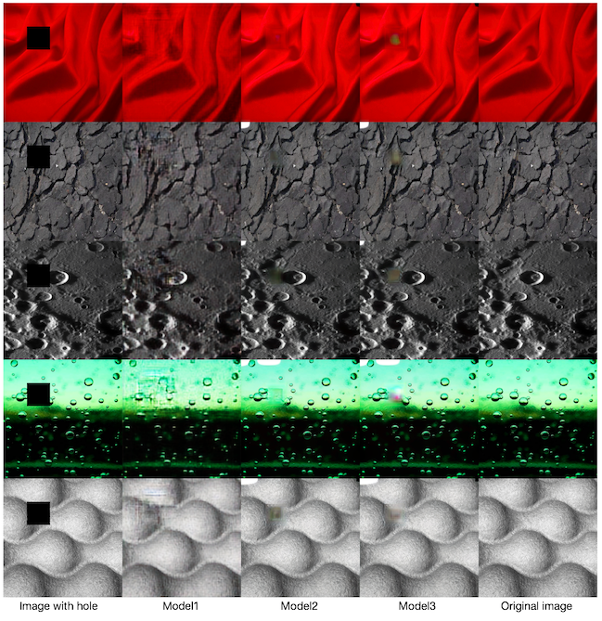
Comparison
We compare with 3 methods:
Model1 : Combination of
Autoencoder and the
onion-peel filling
Model2 : Combination of
UNet and the onion-peel
filling
Model3 : Simple UNet

Slide 42
Comparison
 | The onion-peel filling | The onion-peel filling with limitation | UNet | UNet with the onion-peel filling
Work time | 359.3 s | 118.1 s | 20.8 s | 22.1 s

Slide 43
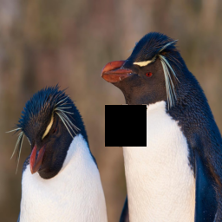
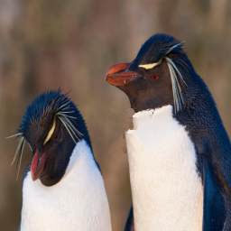
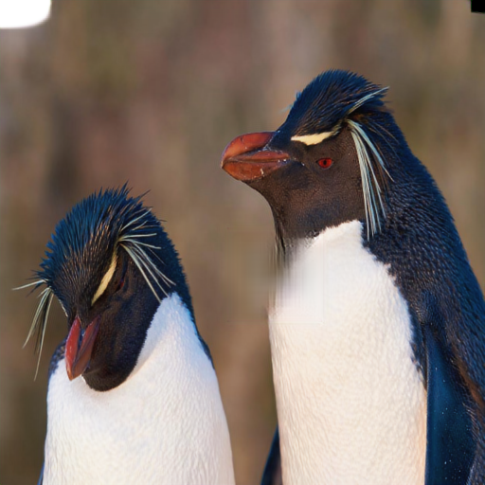

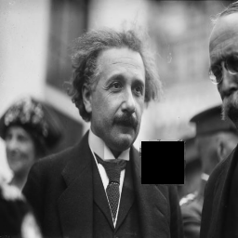
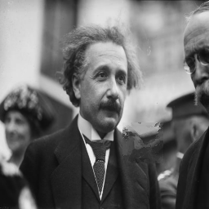
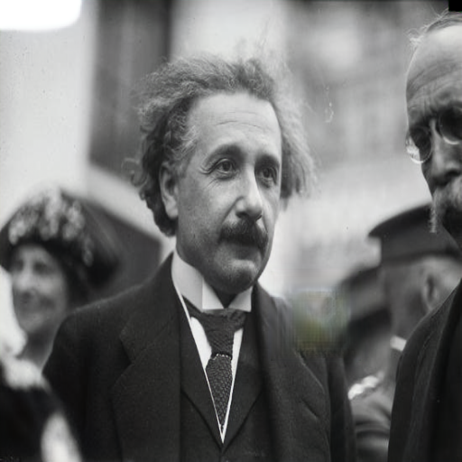
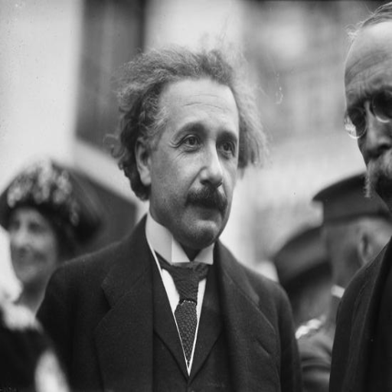
Results
Image with hole
The onion-peel filling
UNet with the onion-peel filling
Original image

Slide 44
Conclusion
The combination of UNet-like architecture network and the onion-peel filling algorithm is the best one not only visually but also by quantitative measure and can robustly handle holes of any shape, location and don't depend on data types (stationary or nonstationary).

Slide 45
References
1. Guilin Liu, Fitsum A. Reda, Kevin J. Shih, Ting-Chun Wang, Andrew Tao, Bryan Catanzaro: Image
Inpainting for Irregular Holes Using Partial Convolutions (2018)
2. "Texture Synthesis by Non-Parametric Sampling", A. A. Efros, T. K. Leung, Proc. IEEE ICCV (1999)
3. Ulyanov, D., Vedaldi, A., Lempitsky, V.: Deep image prior. arXiv preprint arXiv:1711.10925 (2017)
4. Simonyan, K., Zisserman, A.: Very deep convolutional networks for large-scale image
recognition. arXiv preprint arXiv:1409.1556 (2014)
5. Gatys, L.A., Ecker, A.S., Bethge, M.: A neural algorithm of artistic style. arXiv preprint
arXiv:1508.06576 (2015)
6. Johnson, J., Alahi, A., Fei-Fei, L.: Perceptual losses for real-time style transfer and super-resolution.
In: European Conference on Computer Vision. pp. 694-711. Springer (2016)
7. Xiao-Jiao Mao, Chunhua Shen, Yu-Bin Yang : Image Restoration Using Convolutional
Autoencoders with Symmetric Skip Connections (2016)

Slide 46
Thank you!

